Slide 1

MY PORTFOLIO
REACT SUMMER TRAINING
-ANCHIT GUPTA
2018828

Slide 2





TECHNOLOGY USED

Slide 3
PROJECT DESCRIPTION
This project showcase about my profile and testimonials.
This project presents my web development skills on Modern JavaScript Library and Frameworks like React.js
For styling, I use react styled-component and material UI

Slide 4
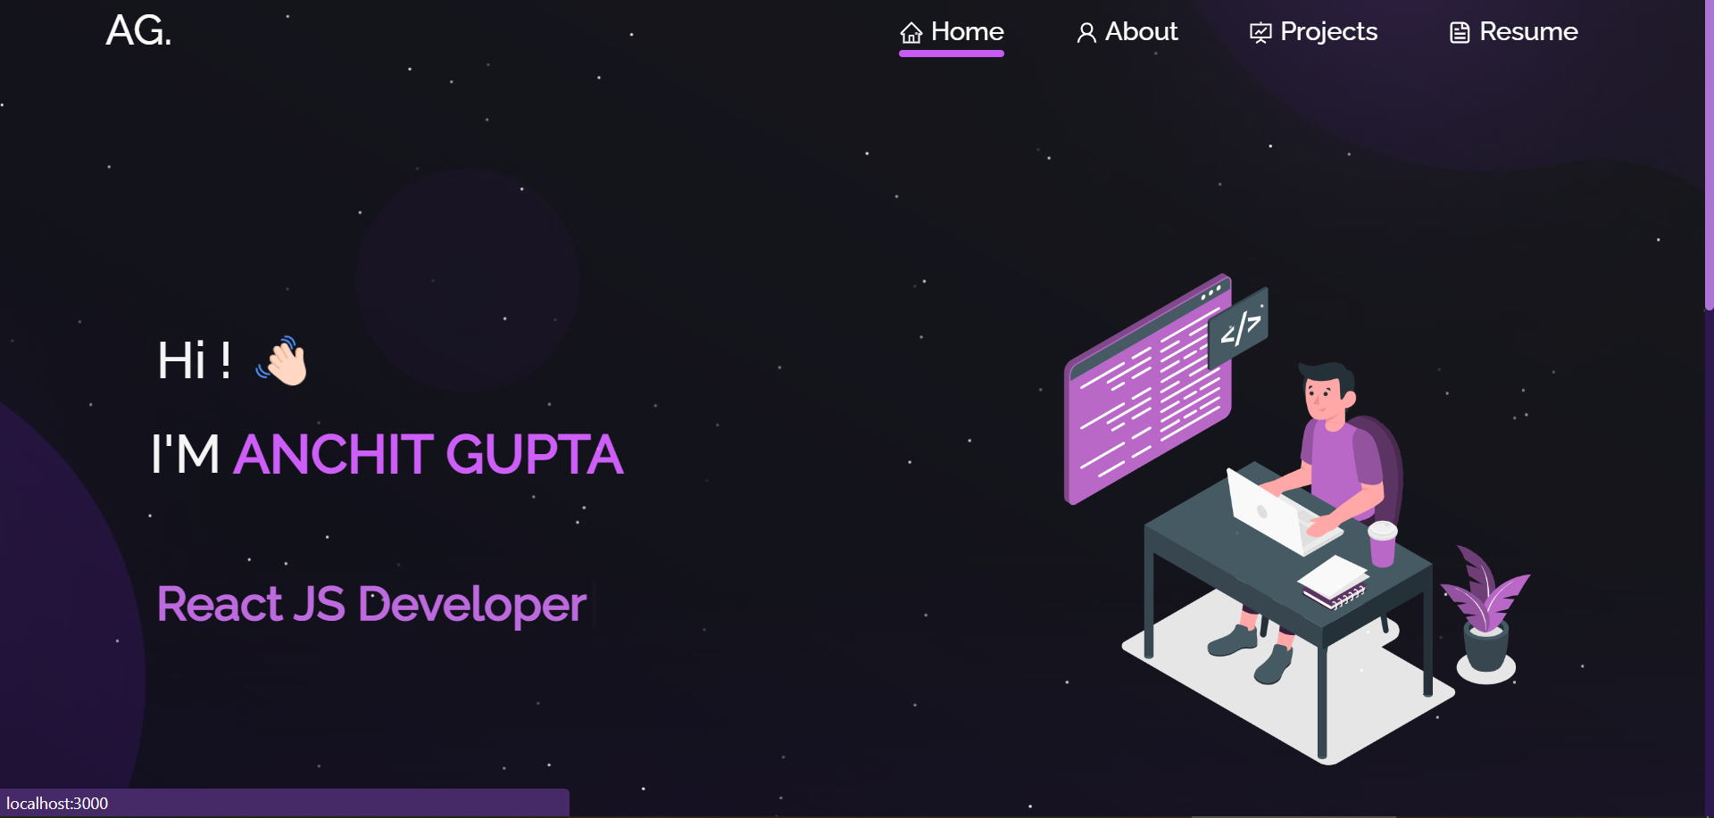
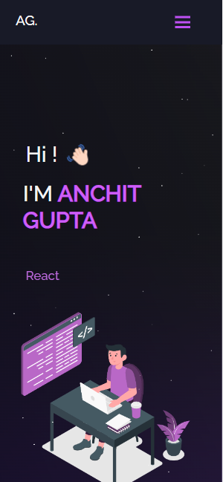
PROJECT INDETAIL
1. HOMEPAGE
Get to know name and my current state of work
UI Elements used –
Header
Type-writer effect
Background effect

Slide 5
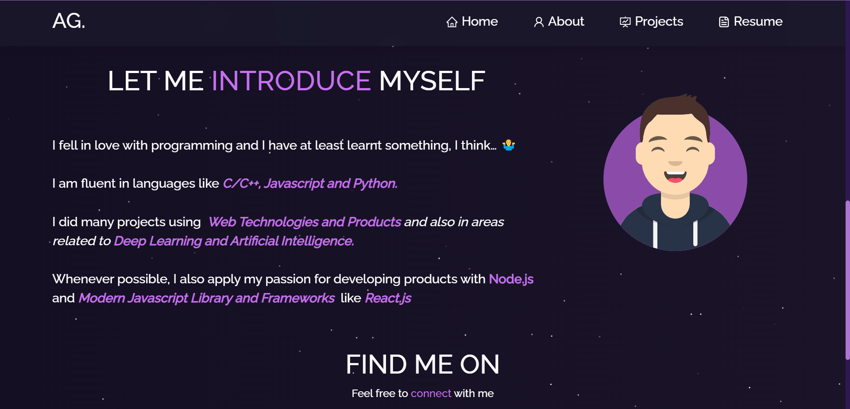
Introduction of myself
UI Elements used –
Header
Avatar tilt
In footer-
React-icons/ai
React-icons/fa

Slide 6
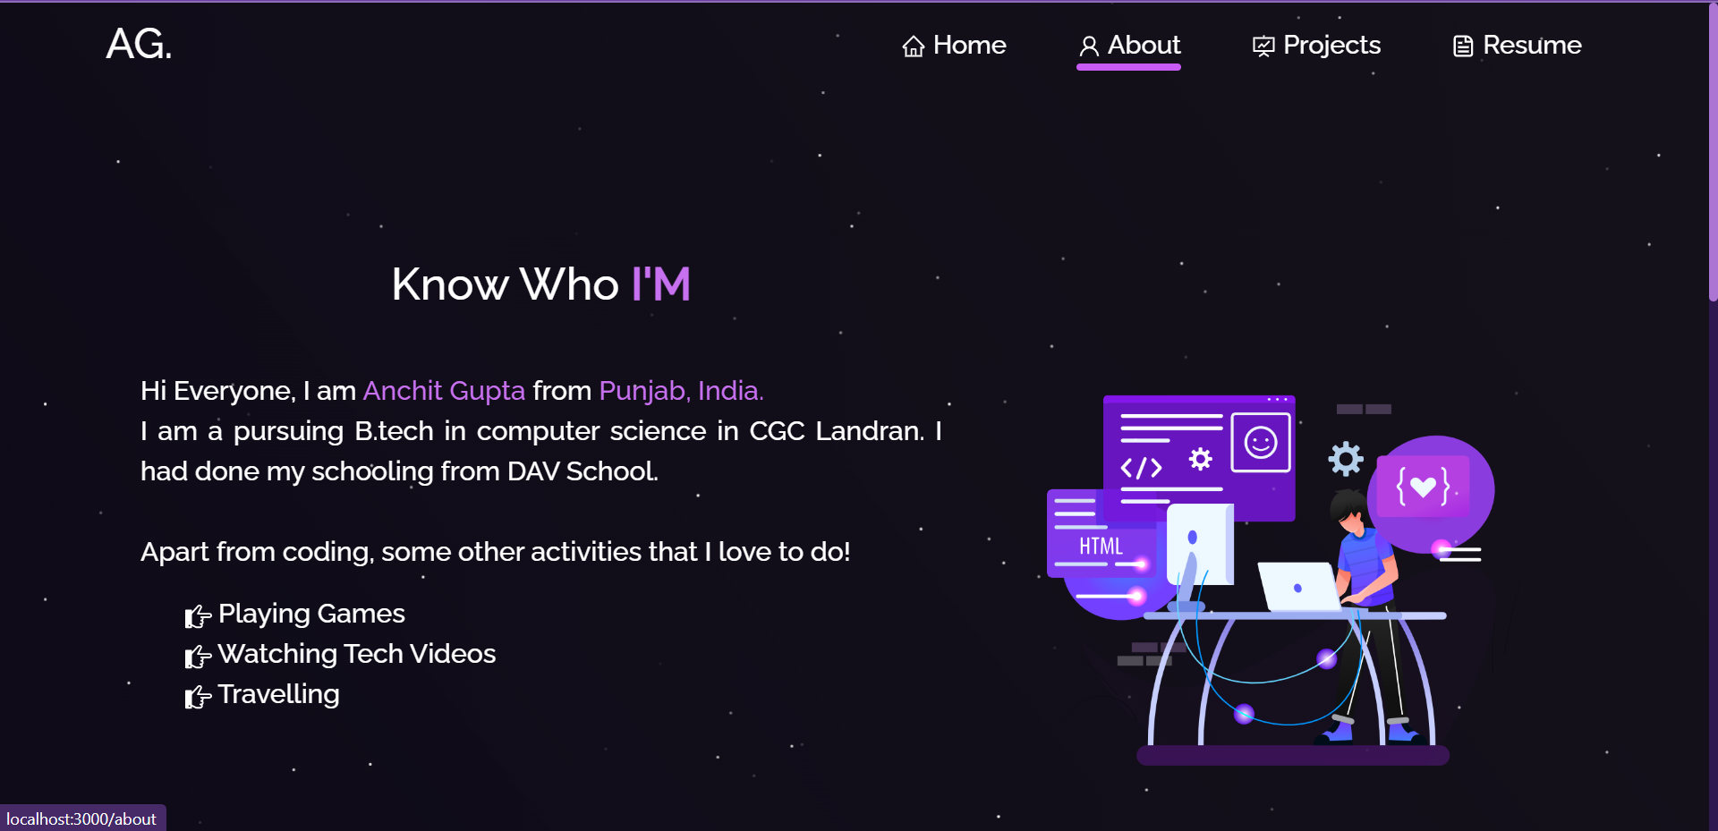
2. ABOUT
Get to know about professional skills
UI Elements used –
React-icons
Techstack
Toolstack
Github-calendar

Slide 7
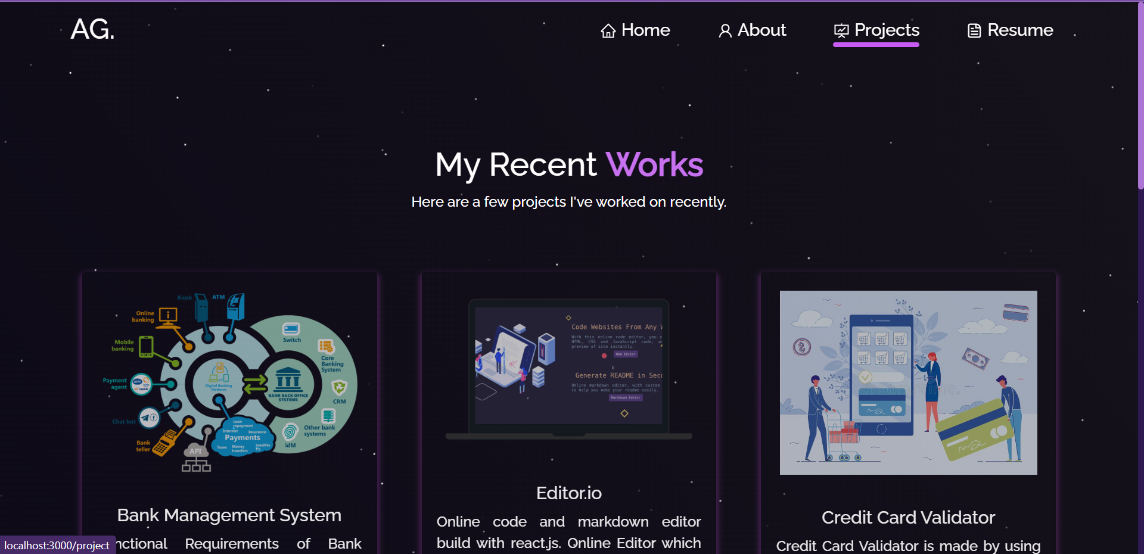
3. PROJECTS
Introduction of myself
UI Elements used in project card–
React-bootstrap/cards
React-bootstrap/buttons

Slide 8
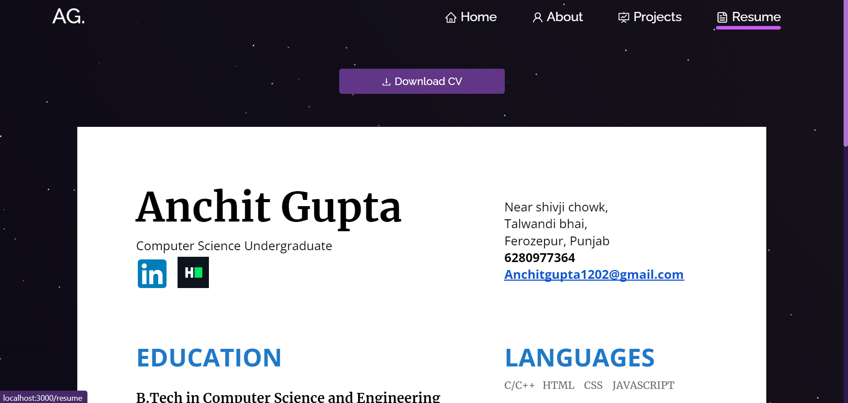
4. RESUME
CV
UI Elements used –
React-pdf
React-icons
React-buttons

Slide 9
SCOPE OF PROJECT
Design a web application of my portfolio that showcase my past workdone and projects.
This web app presents my web development skills on react.js.
In project, I use react.js library, react styled-components and npm for UX/UI designing purpose.
App is build of single page website that helps to optimize the site to much extend.
PORTFOLIO
HOME
PROJECTS
RESUME
ABOUT

Slide 10

THANK YOU!
ANCHIT GUPTA
2018828

